Slide 1

EMBSYS 105 Programming with Embedded & Real-Time Operating Systems
Instructor: Nick Strathy, nstrathy@uw.edu
TA: Gideon Lee, gideonhlee@yahoo.com
© N. Strathy 2020

Slide 2
SD/MMC internals

Slide 3
SD Card Commands
Command Format
Command Classes
Required classes: 0, 2, 4, 5, 8
Basic Commands (Class 0)
Block-Oriented Read Commands (Class 2)
Block-Oriented Write Commands (Class 4)
Erase Commands (Class 5)
Application Specific Commands (Class 8)

Slide 4
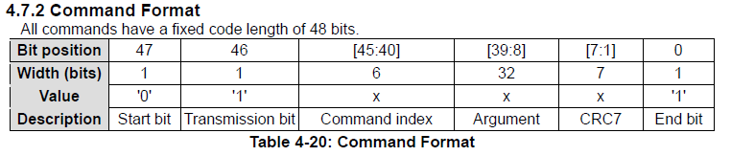
SD Card Commands
SD Card Commands (source sdcard.org)
4 kinds:
Broadcast, no response “bc” – host expects no response from card(s)
Broadcast with response “bcr” – host expects response from card(s)
Addressed (point-to-point) no data transfer on DAT “ac”
Address (point-to-point) data transfer commands, data transfer on DAT “adtc”

Slide 5
SD Card Commands
Command Classes
There are 12 Card Command Classes (CCC), numbered 0-11 based on categories of functionality
A given SD card will support a subset of the 12 classes
All SD cards are required to support at least this set of 5 CCCs:
Basic (class 0)
Block Read (class 2)
Block Write (class 4)
Erase (class 5)
Application Specific (class 8)

Slide 6
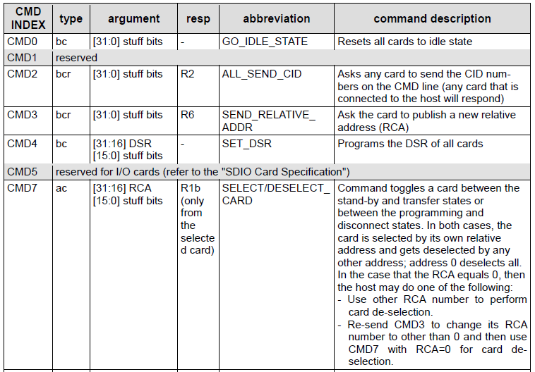
SD Card Commands – Basic commands (Class 0)

Slide 7
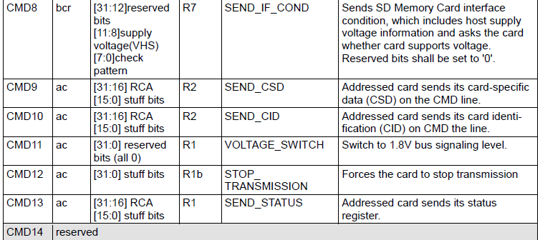

SD Card Commands – Basic commands (Class 0)

Slide 8
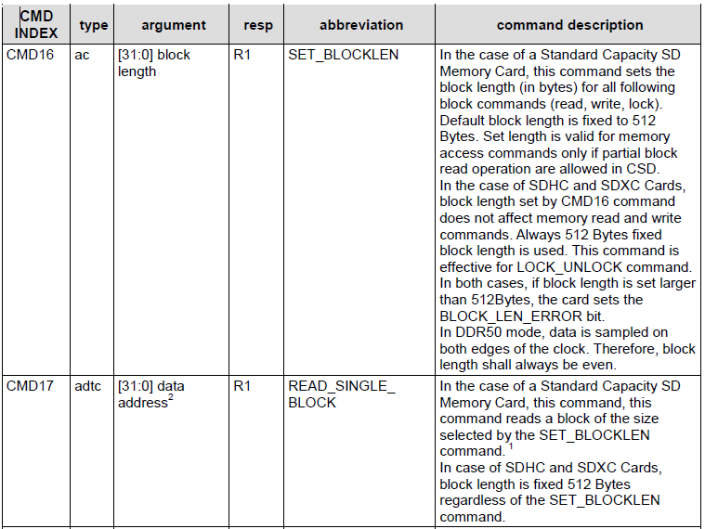
SD Card Commands – Block-Oriented Read Commands (class 2)

Slide 9
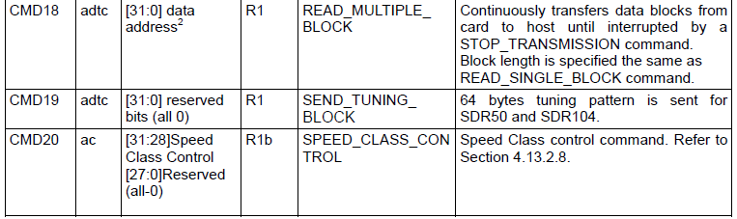
SD Card Commands – Block-Oriented Read Commands (class 2)

Slide 10
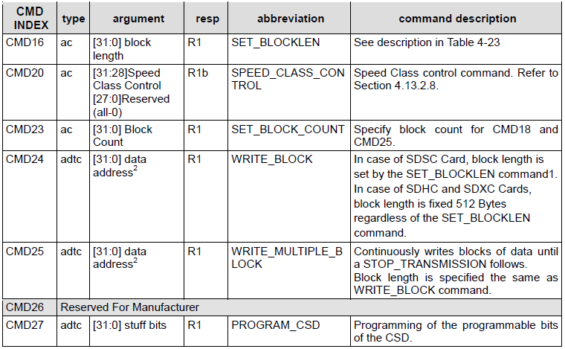
SD Card Commands – Block-Oriented Write Commands (class 4)

Slide 11
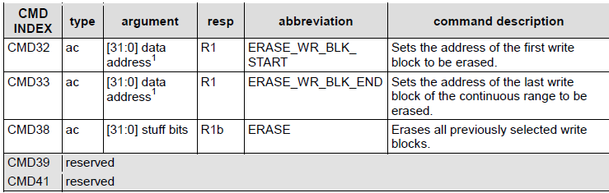
SD Card Commands – Erase Commands (class 5)

Slide 12
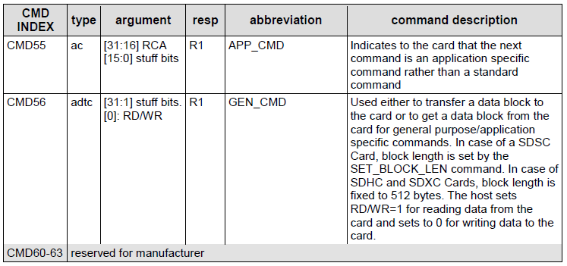
SD Card Commands – Application Specific Commands (class 8)

Slide 13
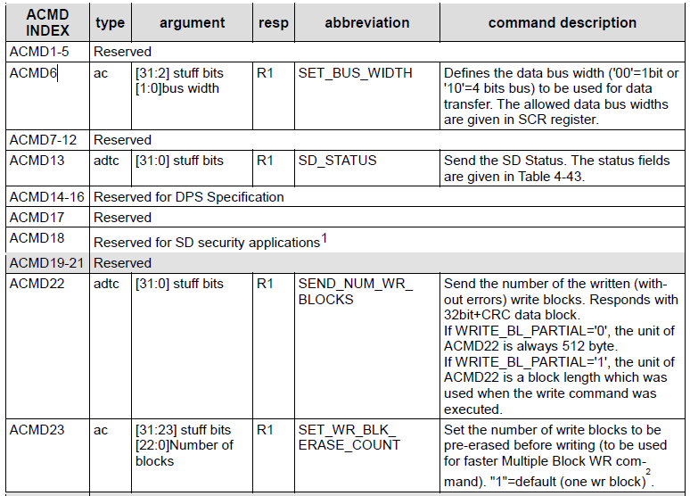
SD Card Commands – Application Specific Commands
“ACMD” commands are used/reserved by the SD card itself

Slide 14
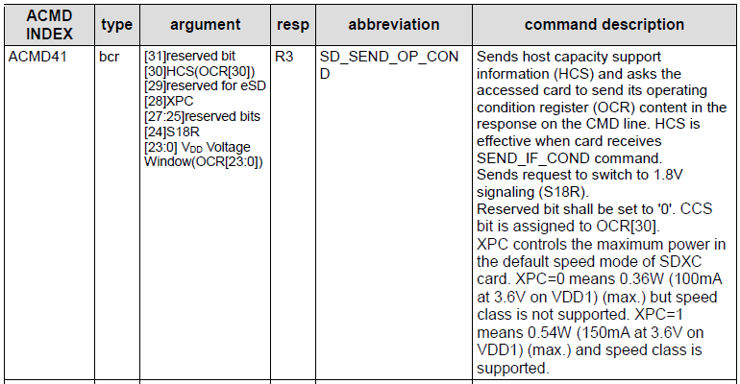
SD Card Commands – Application Specific Commands

Slide 15
SD Command Responses
R1 Response - Normal response (card status)
R2 Response - Card ID (CID) or Card Specific Data (CSD)
R3 Response - Operation Conditions register (OCR)
R6 Response - Published Relative Card Address (RCA)
R7 Response - Card Interface Condition
SD Status Response - 512-bit response to ACMD13

Slide 16
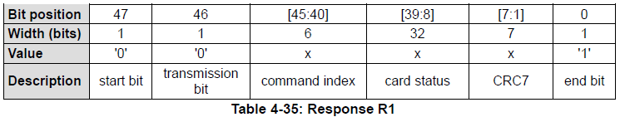
SD Command Responses
Response R1 (R1b includes optional busy signal on data line)
Normal command response
Message length 48 bits

Slide 17
SD Command Responses
Meaning of values in Type and Clear Condition columns in the tables that follow this slide:
Type:
E: Error bit.
S: Status bit.
R: Detected and set for the actual command response.
X: Detected and set during command execution. The host can get the status by issuing a command with R1 response.
Clear Condition:
A: According to the card current state.
B: Always related to the previous command. Reception of a valid command will clear it (with a delay of one command).
C: Clear by read.

Slide 18
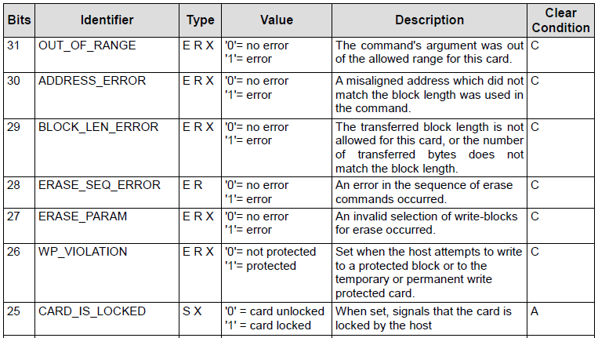
SD Command Responses
Response R1 – Card Status
A 32-bit payload of the R1 response

Slide 19
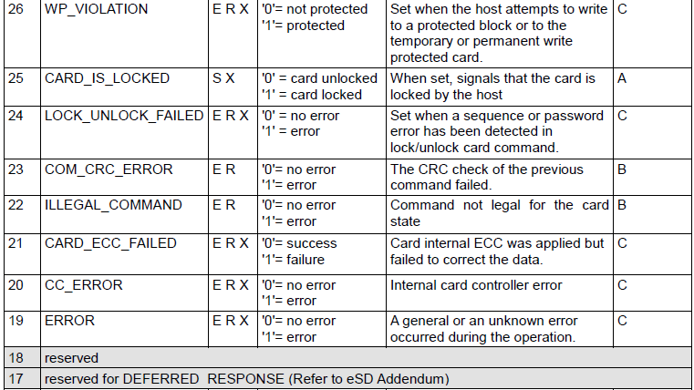
SD Command Responses
Response R1 – Card Status cont’d
A 32-bit payload of the R1 response

Slide 20
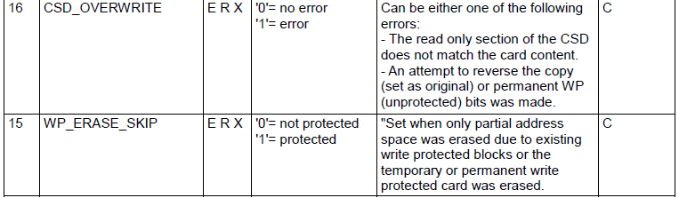
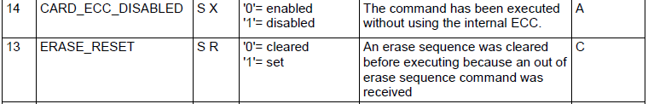
SD Command Responses
Response R1 – Card Status cont’d
A 32-bit payload of the R1 response

Slide 21
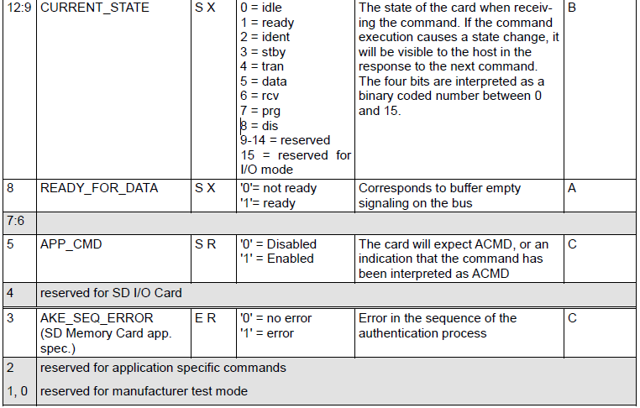
SD Command Responses
Response R1 – Card Status cont’d
A 32-bit payload of the R1 response

Slide 22
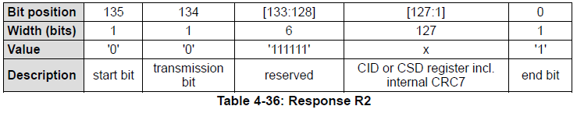
SD Command Responses
Response R2
Card ID (CID) register sent as response to command CMD2 and CMD10
Card specific data (CSD) register sent as response to CMD9.
Message length 136 bits

Slide 23
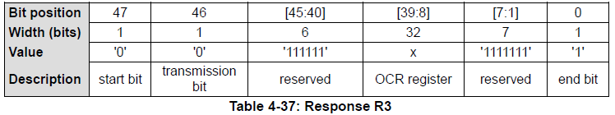
SD Command Responses
Response R3 (Operating conditions register (OCR))
Response length is 48 bits. OCR register is sent as response to ACMD41.

Slide 24
SD Command Responses
Note: Responses R4 and R5 are reserved for SDIO Card Specification

Slide 25
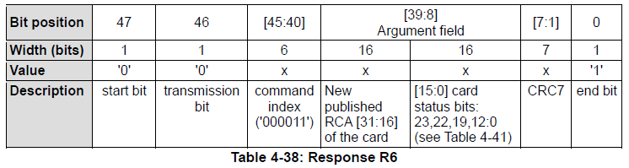
SD Command Responses
Response R6 (Published Relative card address (RCA))
Response length is 48 bits. Response to CMD3
Returns Relative Card Address

Slide 26
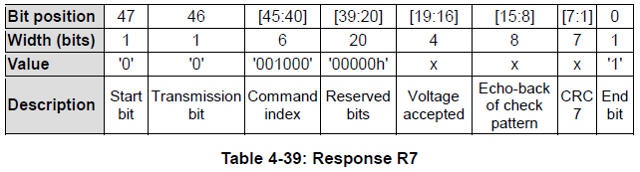
SD Command Responses
Response R7 (Card Interface Condition)
Response length is 48 bits. Response to CMD8
Echoes back the voltage and check pattern sent in the command.
Format of ‘Voltage accepted’ on next slide

Slide 27
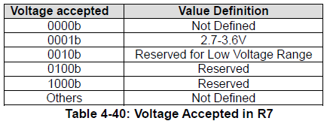
SD Command Responses
Response R7 (Card Interface Condition)
Format of ‘voltage accepted’ in response R7

Slide 28
SD Command Responses
SD Status
The 512-bit response to the ACMD13 command
Size is one data block
Sent over the DAT bus

Slide 29
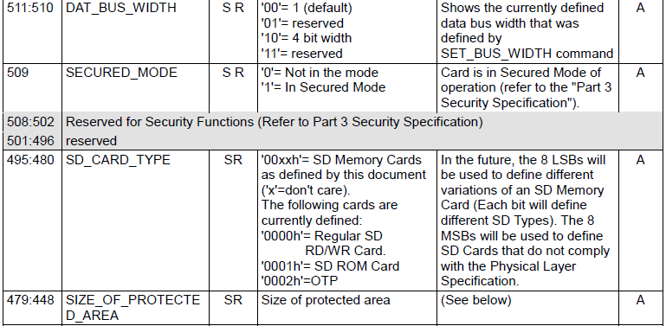
SD Command Responses
SD Status
512-bit response to ACMD13 command
Cont’d …

Slide 30
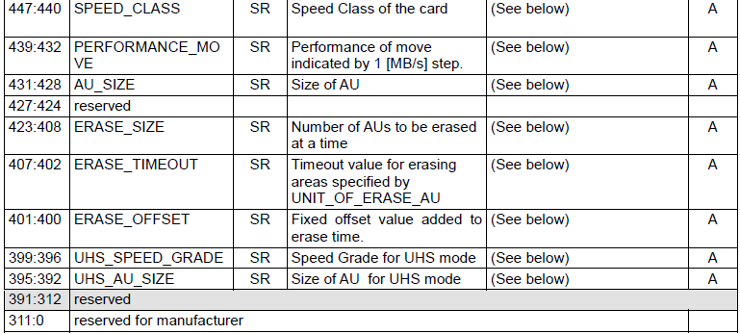
SD Command Responses
[See sdcard.org]
SD Status cont’d
512-bit response to ACMD13 command

Slide 31
SD Card Registers
OCR - Operation Conditions Register
CID - Card Identification Register
CSD - Card-Specific Data Register
RCA Register - Relative Card Address Register
SCR Register - SD Card Configuration Register

Slide 32
SD Card Registers
OCR – Operation Conditions Register provides
VDD voltage profile of non UHS-II card (if bit 29==0)
or VDD1 voltage profile of UHS-II card (if bit 29==1)
Whether card is a Dual Voltage Card (true if bit 7==1 in response to CMD8, or false if bit 7==0)
Whether card is a Standard Capacity Card (true if bit 30==0) or greater than Standard Capacity (SDHC or SDXC) (true if bit 30==1). Bit 30 only valid if Bit 31==1.
Whether the card has completed the card power up procedure (true if bit 31==1, or false if bit 31==0)

Slide 33
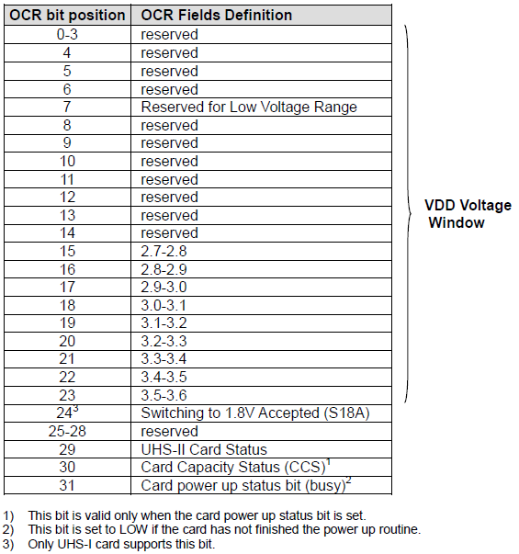
SD Card Registers
OCR – Operation Conditions Register

Slide 34
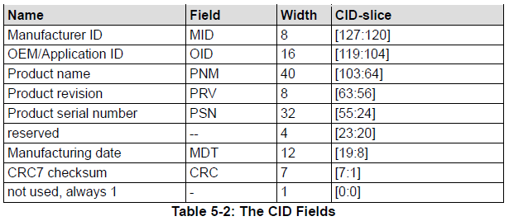
SD Card Registers
CID – Card Identification Register
Every card has a 128-bit unique ID number

Slide 35
SD Card Registers
CSD – Card-Specific Data Register
Consists of 128 bits which provide information regarding access to the card contents such as
maximum data access time
whether card is permanently, temporarily, or not write protected
Fields related to card capacity
Note that there are 2 versions of this register CSD V1.0 and CSD V2.0!
Bits [127:126] specify the version

Slide 36
SD Card Registers
RCA Register – Relative Card Address Register
The writable 16-bit Relative Card Address Register carries the card address that is published by the card during card identification.
This address is used for addressed host-card communication after the card identification procedure.
The default value of the RCA register is 0x0000. The value 0x0000 is reserved to set all cards into the Stand-by State with CMD7.

Slide 37
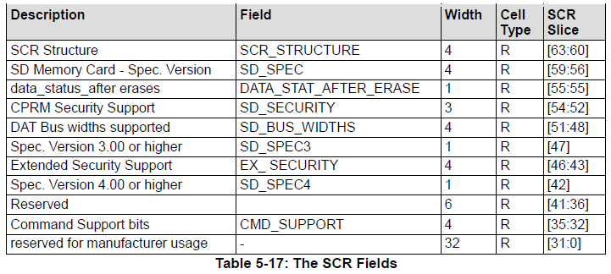
SD Card Registers
SCR Register – SD Card Configuration Register
Consists of 64 bits of card specific configuration data
Allows host to determine which SD spec the card supports, etc.

